Slide 1
Topics
File System
Problems with file system
Data redundancy
Database environment components
DBMS functions

Slide 2
Manual File Systems
Collection of file folders kept in file cabinet
Organization within folders based on data’s expected use (ideally logically related)
Finding and using data in growing collections of file folders became time-consuming

Slide 3
What are the drawbacks of file-based system?
Data Redundancy: Data is duplicated in multiple places.
Data Inconsistency: Updates made in one file may not be reflected in other files.
Lack of Data Integrity: Errors in data entry or inconsistencies compromise data reliability.
Limited Data Sharing and Retrieval: File systems do not allow multiple users to access or retrieve data efficiently.
Data Security: Lacks robust security features.
Scalability Issues: Difficult to scale as data grows.
Backup and Recovery Challenges: Manual systems are difficult to backup and recover.

Slide 4
Advantages of DBMS compared to file-based system
Data Integrity & Consistency: Ensures reliable, accurate data.
Data Security: Provides robust access controls.
Concurrent Data Access: Multiple users can access data without conflicts.
Efficient Data Retrieval: SQL queries enable fast retrieval of complex data.
Scalability: Databases can easily grow with the organization.
Data Backup & Recovery: Automates backup and recovery processes.

Slide 5
Evolution of database
Flat file database
Hierarchical database
Network database
Relational database
Non-relational database

Slide 6

Basic File Terminology
Data: Raw facts, has less meaning unless organized
Field: a character or group of character to categorize data types
Record: combination of fields to define a object .
File: collection of records

Slide 7
Flat File database
A simple, single-table database where all data is stored in rows and columns (like a spreadsheet).
Two dimensional
No complex relationship
Limitation: Does not support relationships like "one-to-many" or "many-to-many" between records.
Example: CSV files, text files.

Slide 8

Hierarchical Database
A hierarchical database is a type of database management system (DBMS) that organizes and represents data in a hierarchical or tree-like structure.
Parent-Child relationship
Navigational access
Limited flexibility

Slide 9
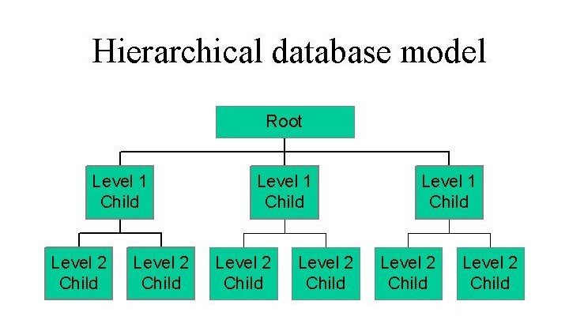
Hierarchical Database Model

Slide 10
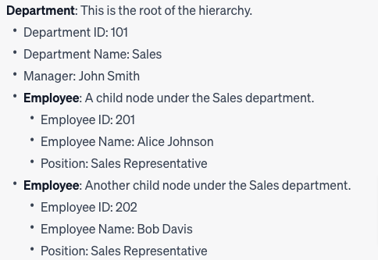
Hierarchical database example

Slide 11
Characteristics:
Tree Structure: A single parent with multiple children.
Use Case: Useful when data has a clear, one-to-many relationship (e.g., an organization with departments, employees, etc.).
Limitation: Limited flexibility, as each child can have only one parent. To establish more complex relationships, a different model is needed.
Example: IBM's Information Management System (IMS).

Slide 12
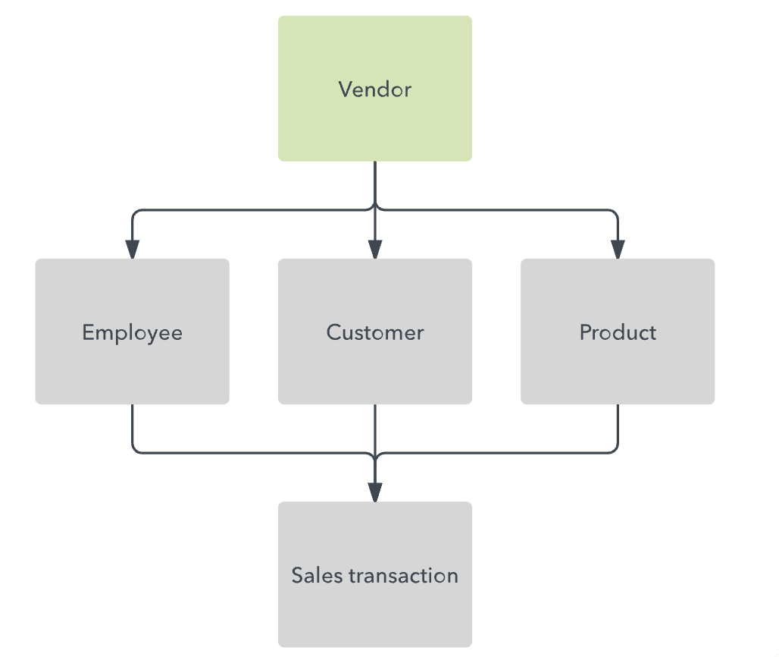
Network database
A network database is based on a traditional hierarchical database, except it allows each object to have multiple parents instead of a single parent.

Slide 13
Network Database
A Network Database is more flexible than the hierarchical model, allowing records (or nodes) to have multiple parents and children.
This many-to-many relationship is ideal for modeling more complex real-world scenarios, where entities may have multiple associations
Flexible Relationships: Many-to-many relationships are supported.
Use Case: Used in complex systems such as university databases, airline reservation systems, etc., where entities have multiple relationships.
Limitation: It can be more challenging to manage due to its complexity.
Example: Integrated Data Store (IDS).

Slide 14
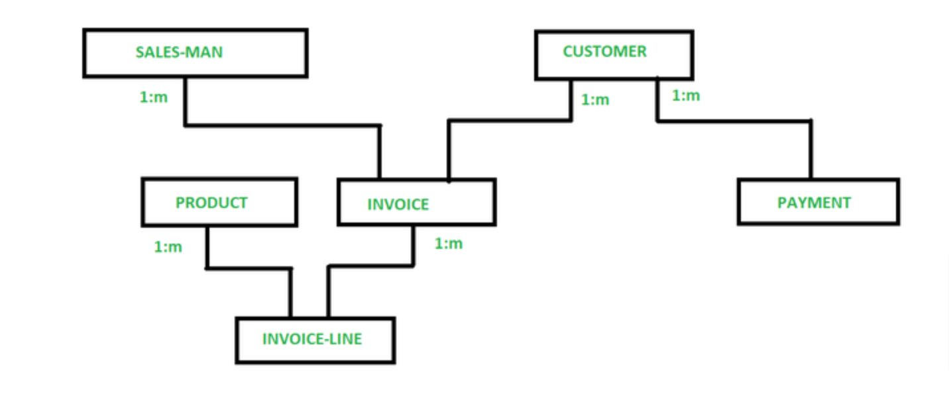
Network database

Slide 15
Relational Database
Data is stored in tables (also called relations) with rows and columns. Tables can be linked using primary and foreign keys, which allows for flexible querying using SQL
Use Case: Most widely used type, great for structured data with well-defined relationships. Ideal for applications like CRM systems, loan management systems, and financial records.
Example: MySQL, PostgreSQL, Microsoft SQL Server.

Slide 16
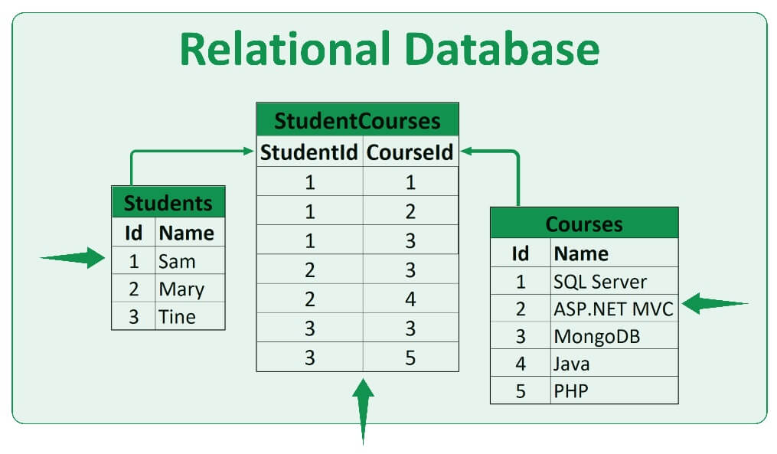
Relational Database

Slide 17
Non relational Database
Data can be stored in various forms like key-value pairs, document-oriented, column-family, or graph databases. NoSQL databases are often more flexible with data structure and scale well horizontally. Use Case: Best suited for handling unstructured or semi-structured data, rapid development, and large-scale applications (e.g., social media, big data analytics).
Example: MongoDB (document), Cassandra (column-family), Redis (key-value), Neo4j (graph).

Slide 18
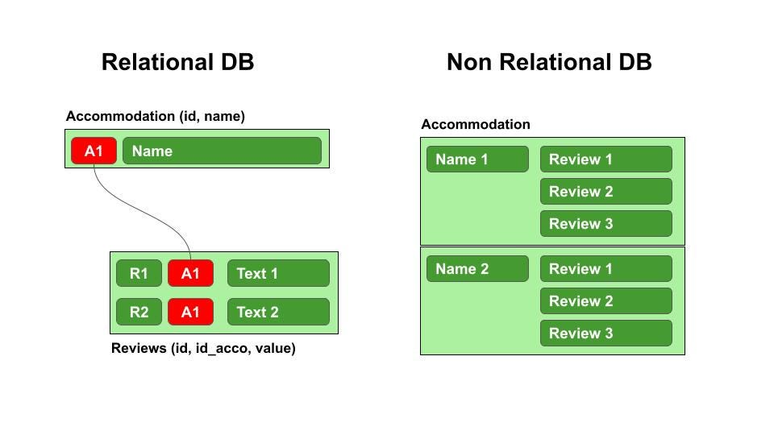
Non relational Database

Slide 19
Sample Questions
Mr. Bolton owns a small-scale retail shop which sells stationary. For the past few years, he had been using the Excel sheet file-based system to record his sales and inventory. However, as his business grows, he found that this method of recording sales and inventory is inefficient. Based on this case, elaborate THREE (3) drawbacks of the file-based system approach.
Refer to question (1) above, Mr. Bolton is advised to convert his sales and inventory record into using a Database Management System (DBMS). Based on your opinion, discuss THREE (3) advantages of DBMS compare to the file-based system.
Describe THREE (3) functions provided by DBMS.

Slide 20
What is data redundancy?
Data redundancy refers to the duplication of data within a database or across multiple databases within an organization's information system. In other words, it occurs when the same piece of data is stored in more than one place.

Slide 21
Advantages of Data Redundancy
Improved Data Retrieval Performance
Enhanced Data Availability
data integrity validation

Slide 22
Disadvantages of data redundancy
Data Inconsistency
Increased Storage Costs
Complexity
Data Security Risks
Maintenance Challenges

Slide 23
Redundancy Example
student_id | student_name | student_age | dept_id | dept_name | dept_head
1 | Tony Stark | 18 | 100 | Computer Science | Steve Rogers
2 | Thor Odinson | 18 | 100 | Computer Science | Steve Rogers
3 | Bruce Banner | 18 | 101 | Mechanical | Natasha Romanoff

Slide 24
Data Anomalies
Data anomalies are data points or sets of data that deviate from the expected patterns or behaviours in a dataset.
Data anomalies occur when there are inconsistencies, errors, or deviations in a database due to improper handling of data.
These anomalies typically arise in poorly designed databases, especially when normalization rules are not followed.
Types of data anomalies
Insert Anomaly - This anomaly arises because the database schema forces the storage of incomplete or irrelevant data when inserting new records.
Update Anomaly - Occurs when data is stored redundantly in multiple places, and updating one instance of the data does not automatically update the other occurrences
Delete Anomaly - Occurs when the deletion of certain data unintentionally removes other important data.

Slide 25
Question
Consider a college database that keeps student information in a table called student, which contains four columns: stu_id for the student's id, stu_name for the student's name, stu_address for the student's address, and stu_club for the student's club.
Give examples of insert, update and delete anamoly

Slide 26
Components in database environments
Database system is composed of five main components:
Hardware - The physical devices where databases are stored (servers, storage devices).
Software
Operating system software
DBMS software
Application programs and utility software
People - DB administrators, developers, and users
Procedures - Rules and instructions that govern the database operations
Data

Slide 27
Functions of DBMS
Data dictionary management: defines data elements and their relationships
Data storage management: stores data and related data entry forms, report definitions, etc.
Data transformation and presentation: translates logical requests into commands to physically locate and retrieve the requested data
Security management: enforces user security and data privacy within database
Multiuser access control: uses sophisticated algorithms to ensure multiple users can access the database concurrently without compromising the integrity of the database
Backup and recovery management: provides backup and data recovery procedures
Data integrity management: promotes and enforces integrity rules

Slide 28
Functions of DBMS
Multiuser access control: uses sophisticated algorithms to ensure multiple users can access the database concurrently without compromising the integrity of the database
Backup and recovery management: provides backup and data recovery procedures
Data integrity management: promotes and enforces integrity rules
Database access languages and application programming interfaces: provide data access through a query language
Database communication interfaces: allow database to accept end-user requests via multiple, different network environments

Slide 29
Thank You !!!

